Slide 1
CPACS Introduction

Slide 2


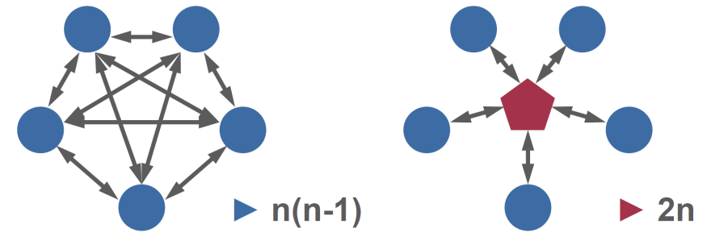















Central Standard Data - Introduction
Disciplinary Experts
Operations
Structure
Aerodynamics
On board systems
Management
Material
Propulsion
Mission performance
Flight control

Slide 3


Central Standard Data - Introduction
Disciplinary Experts
Operations
Structure
Aerodynamics
On board systems
Management
Material
Propulsion
Mission performance
Flight control
Common Parametric Aircraft Configuration Schema

Slide 4
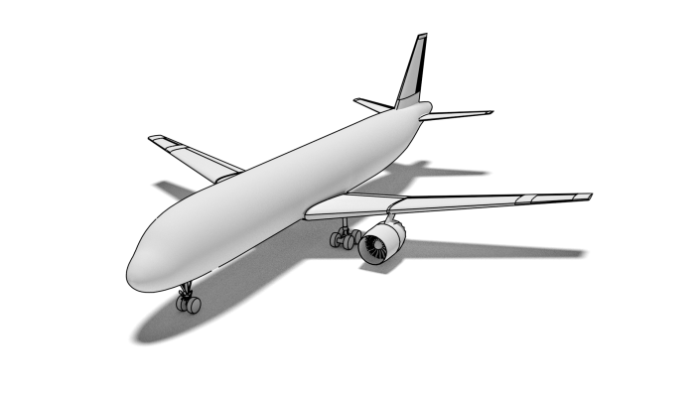
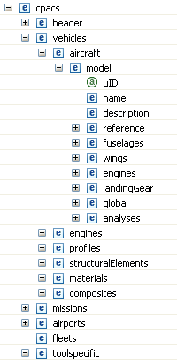
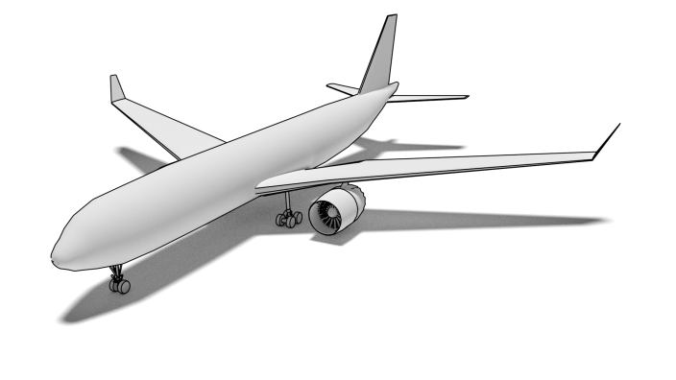
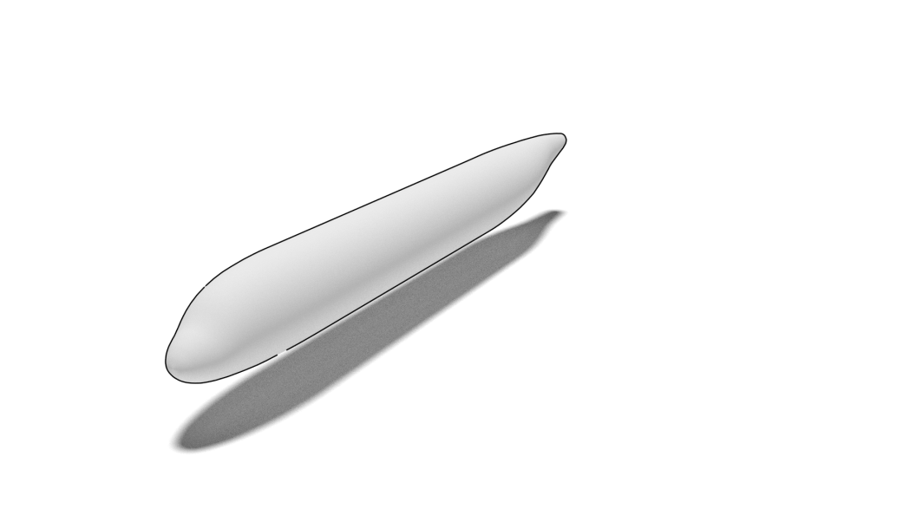
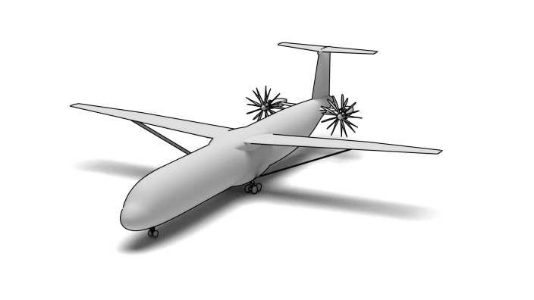
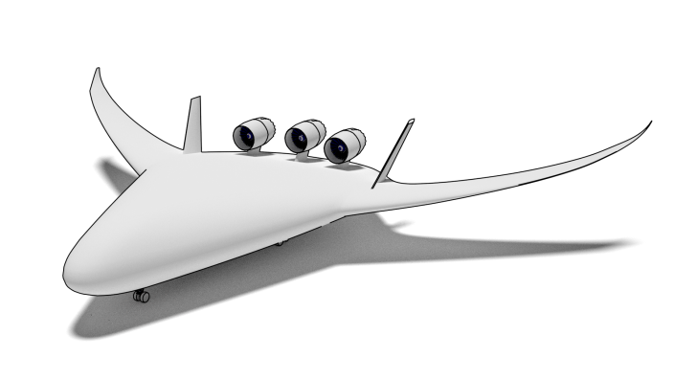
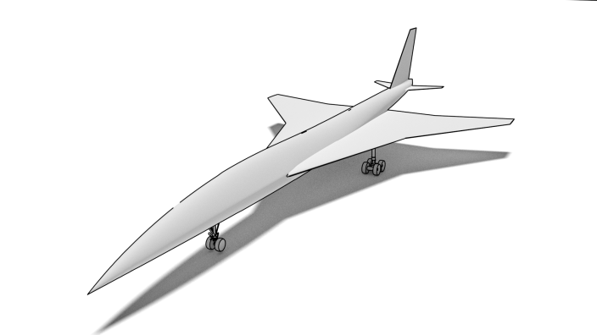
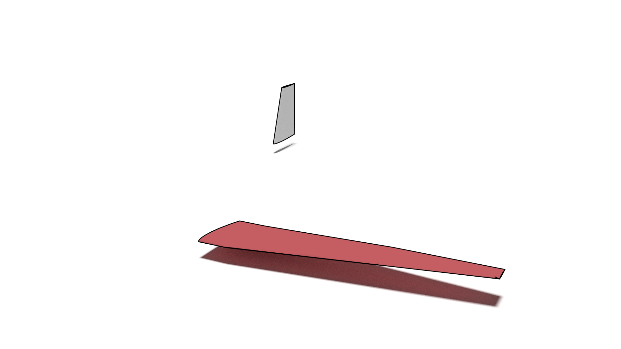
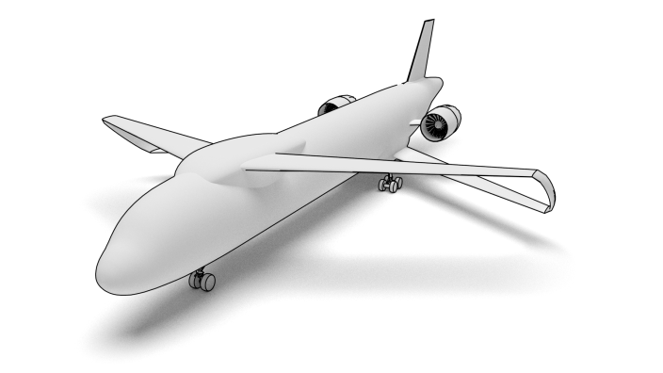
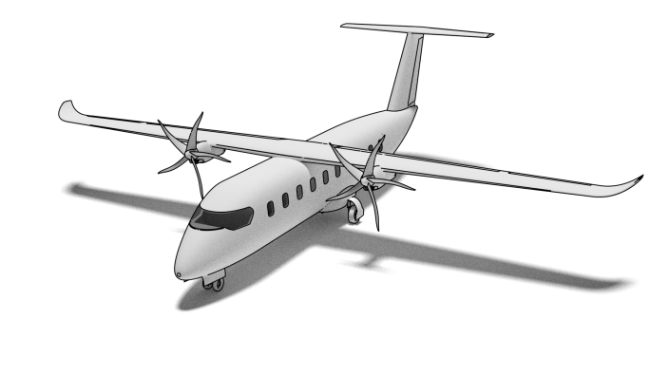
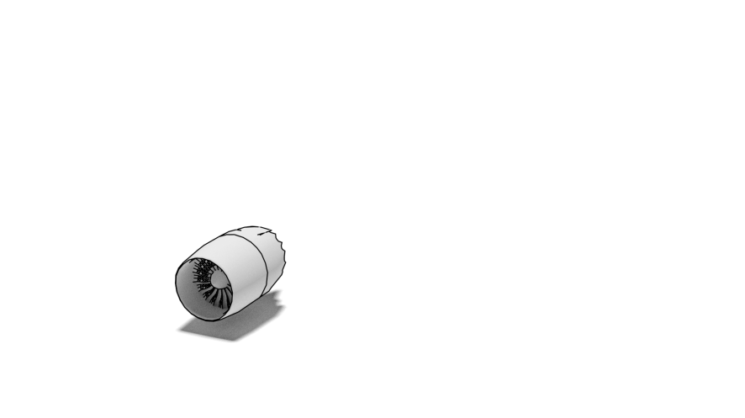
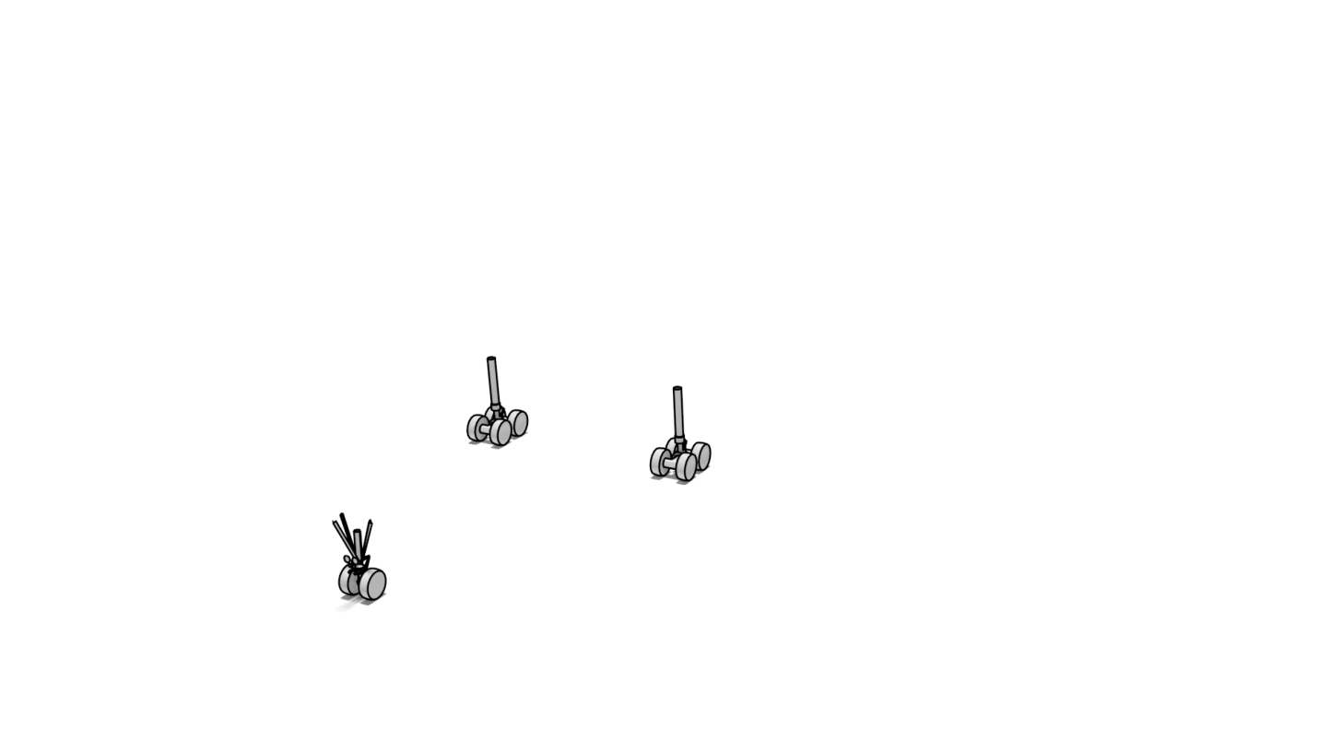
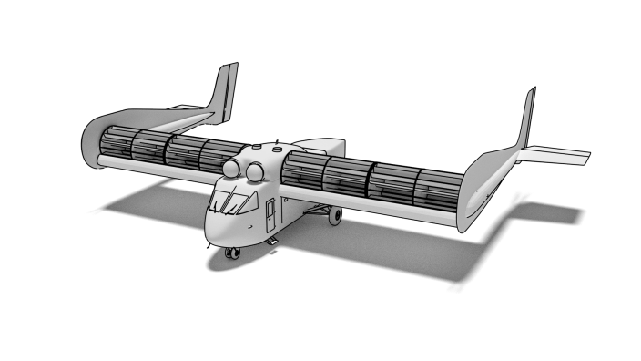
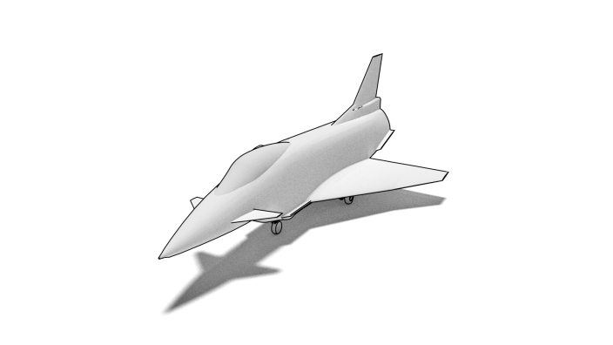
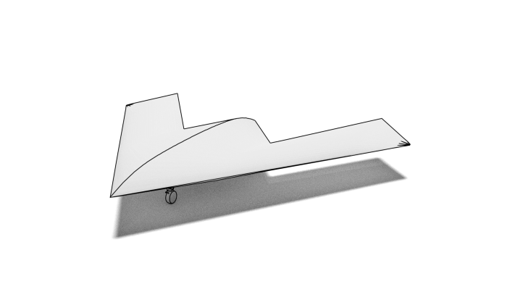


CPACS: Common Parametric Aircraft Configuration Schema
Hierarchical Structure
2. level
3. level
4. level
top level

Slide 5

CPACS: Common Parametric Aircraft Configuration Schema
Hierarchical Structure
Common language for aircraft design
Exchange of specialist knowledge
Developed since 2005, based on XML / XSD
Human readable
Standardized
Contains product and process information
Open-source
2. level
3. level
4. level
top level

Slide 6

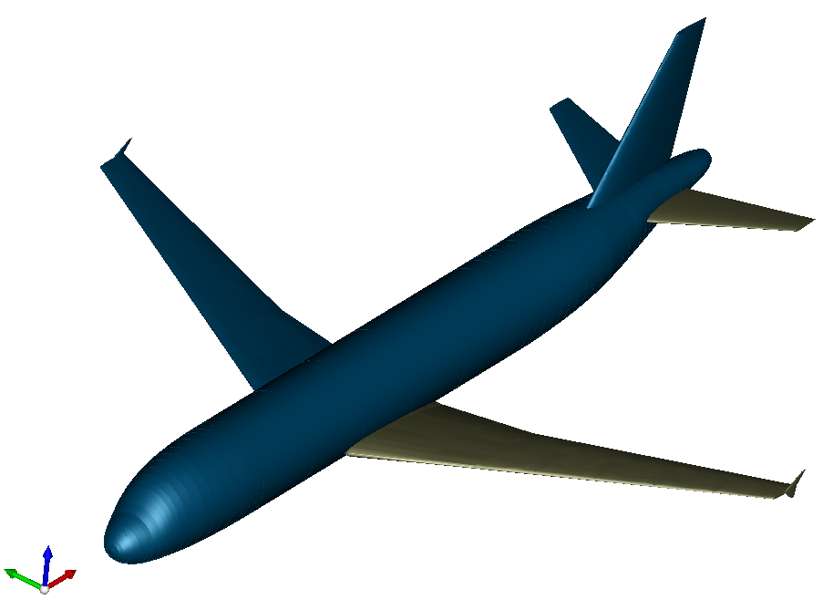
CPACS: Common Parametric Aircraft Configuration Schema
Hierarchical Structure
Common language for aircraft design
Exchange of specialist knowledge
Developed since 2005, based on XML / XSD
Human readable
Standardized
Contains product and process information
Open-source
Supporting libraries:
TIXI: fast & simple XML Interfacing
TIGL: Geometric Library (based on OpenCASCADE)
- query functions: tiglGetWingArea
- export to IGES/VTK
- geometry viewer
external interfaces for: C, C++, Python, Java, MATLAB and Fortran
2. level
3. level
4. level
top level

Slide 7



Tool integration framework
Supports data exchange via CPACS files
Aircraft design tool
Python
Aircraft data ontology
Schema: XSD
Data: XML
TiXI
TiXI: TiXI XML Interface
Extends LibXML2 with individual functionalities
TiGL: TiGL Geometry Library
Based on OpenCascade
(Additional) methods for geometric operations
Viewer

Slide 8





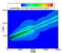
CPACS: Common Parametric Aircraft Configuration Schema
Hierarchical Structure
automate
input
select
map
existing analysis module
input
selection
input
→
2. level
3. level
4. level
top level
supporting libraries (optional)
execute analysis
file handling
geometry handling
output
updated
provide output
map
output
output
←
output

Slide 9
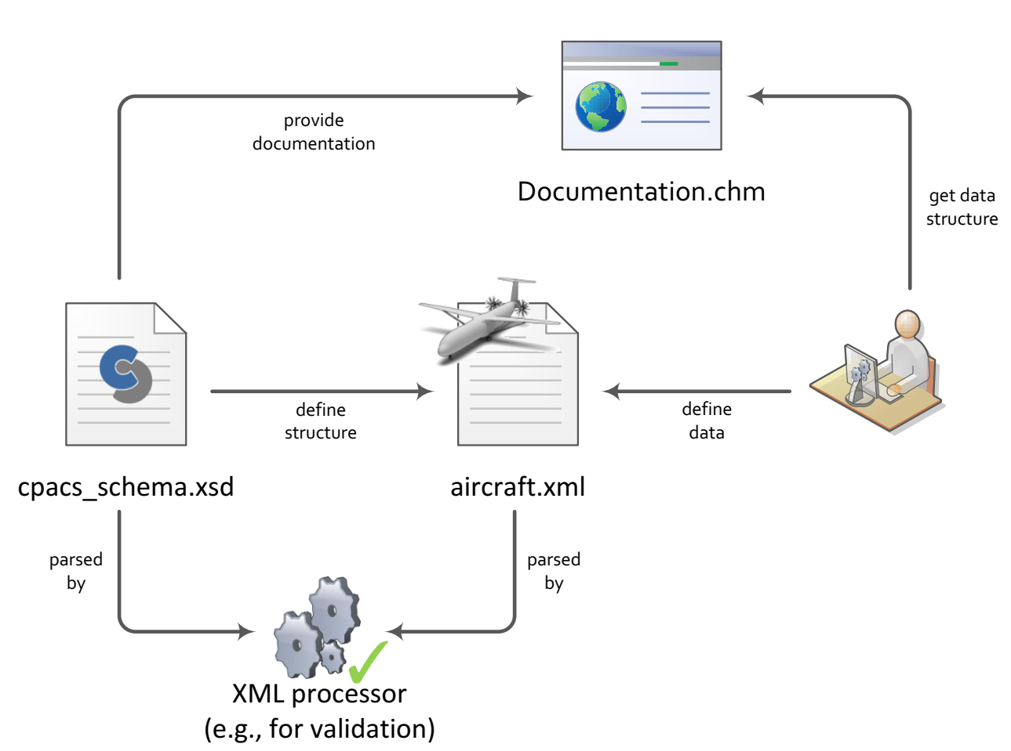
XSD and XML

Slide 10


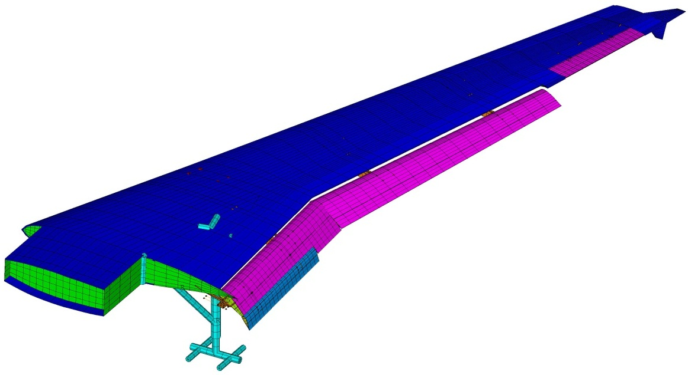

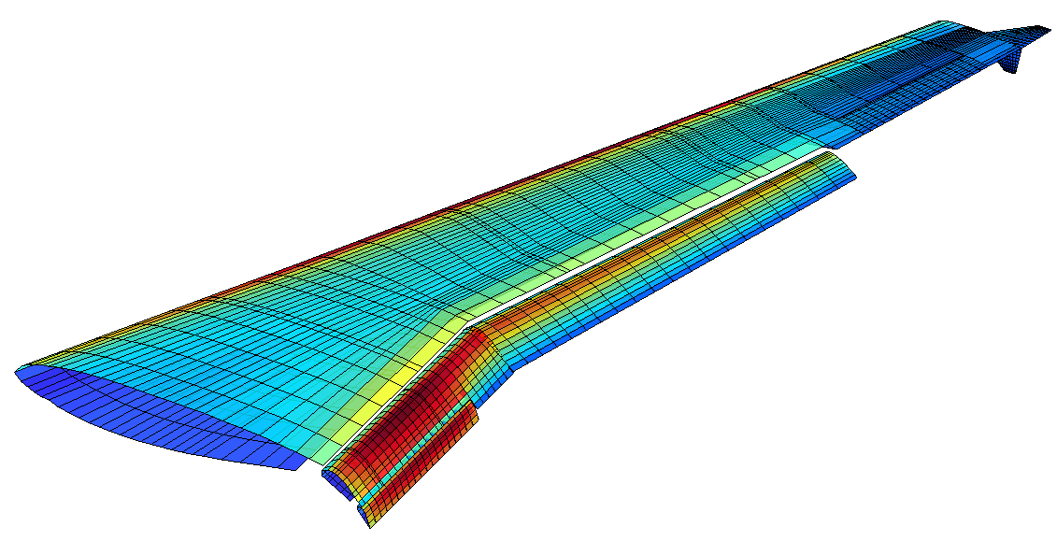
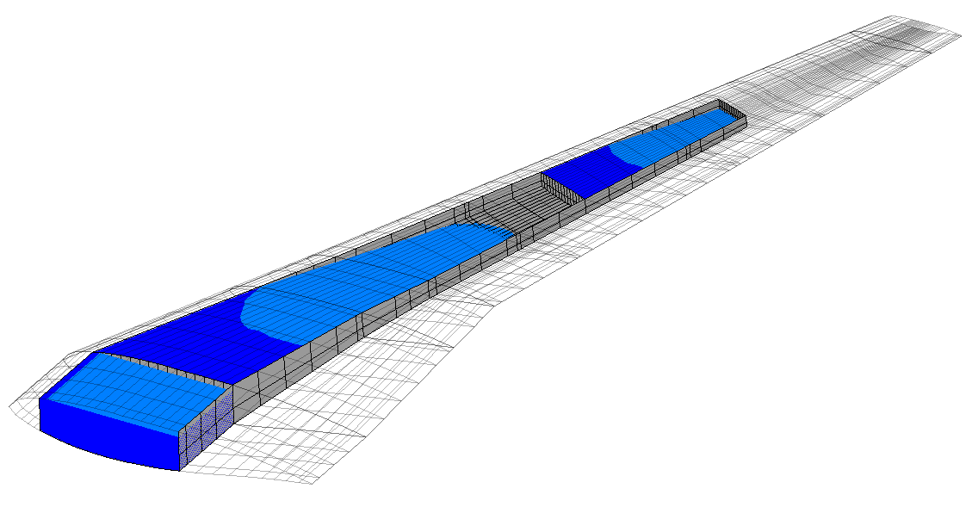
Using CPACS for parametric design
Requirements
Multi-Disciplinary Modelling
Design Optimization
Parameter
Optimization
Structure
Iteration → Synthesis
Datenbank
Engineering Service 1
MDA System
Meta-Model
Engineering Service 2
Aerodynamics
Engineering Service n
Loads
Sensitivity
Performance,
Properties
Assessment

Slide 11
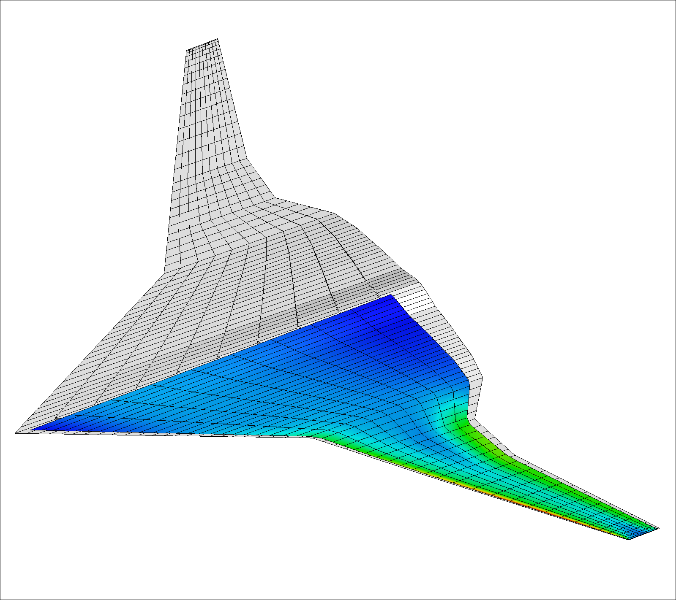
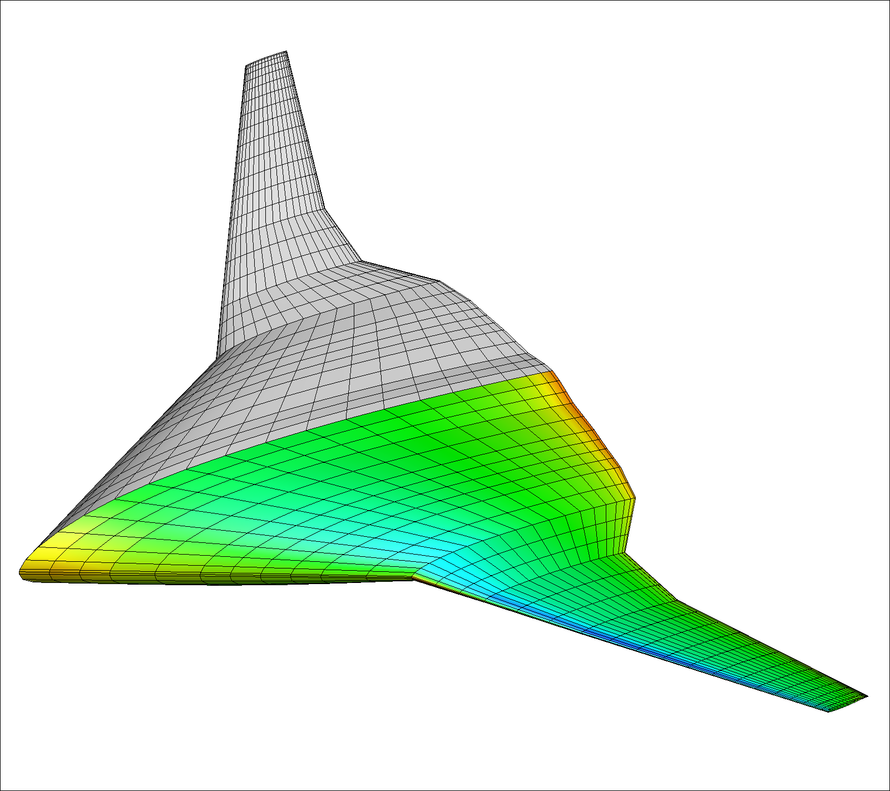
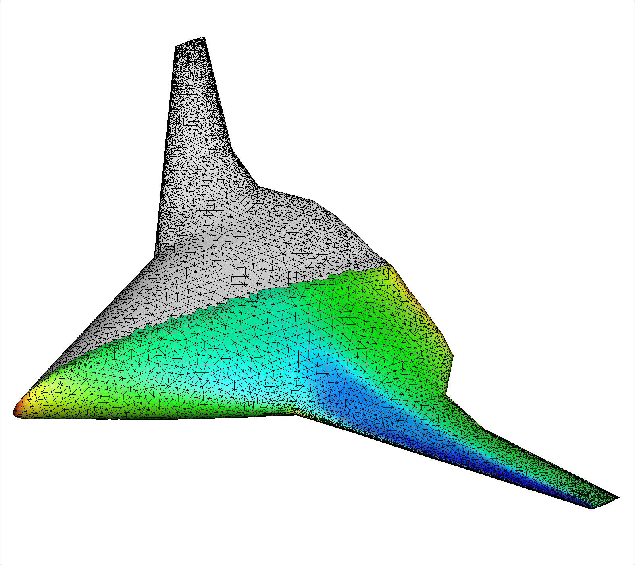
Using CPACS for parametric design
Requirements
Multi-Fidelity Modelling
Design Optimization
Parameter
Optimization
Lifting_Line
Iteration → Synthesis
Datenbank
Engineering Service 1
MDA System
Meta-Model
Engineering Service 2
3D Panel
Engineering Service n
Euler
Sensitivity
Performance,
Properties
Assessment

Slide 12
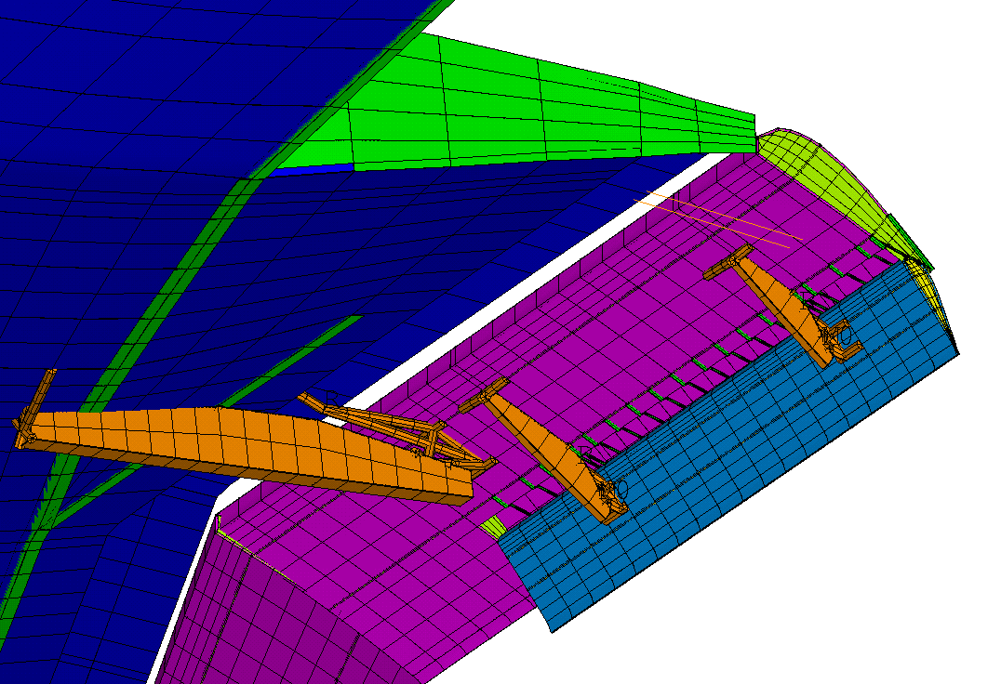
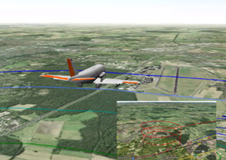
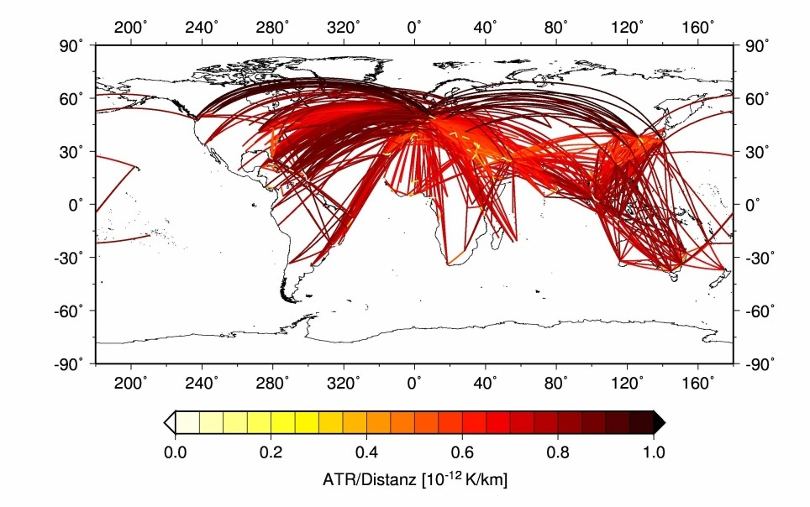
Using CPACS for parametric design
Requirements
Multi-Scale Modelling
Design Optimization
Parameter
Optimization
Component
Iteration → Synthesis
Datenbank
Engineering Service 1
MDA System
Meta-Model
Engineering Service 2
Aircraft
Engineering Service n
Fleet
Sensitivity
Performance,
Properties
Assessment

Slide 13

CPACS
What is CPACS?
What CPACS is not:
CPACS is an aircraft „ontology“ defined in XML Schema Definition (XSD)
It describes things and their relations using XS.D syntax
CPACS is multi disciplinary and multi scale
airlines & operations
airports & runways
aircraft performance, requirements, mission & loads
components & subcomponents (high lift devices, fuel tanks, …)
structural layout & details (ribs, spars, beams, stringers)
decks, cabin geometry, aisles doors, floors, seats
CPACS contains ~1000 type definitions
CPACS is not a tool
CPACS does not contain any functionality
It can not compute, show or do anything
CPACS is the enabler for collaborative aircraft design

Slide 14
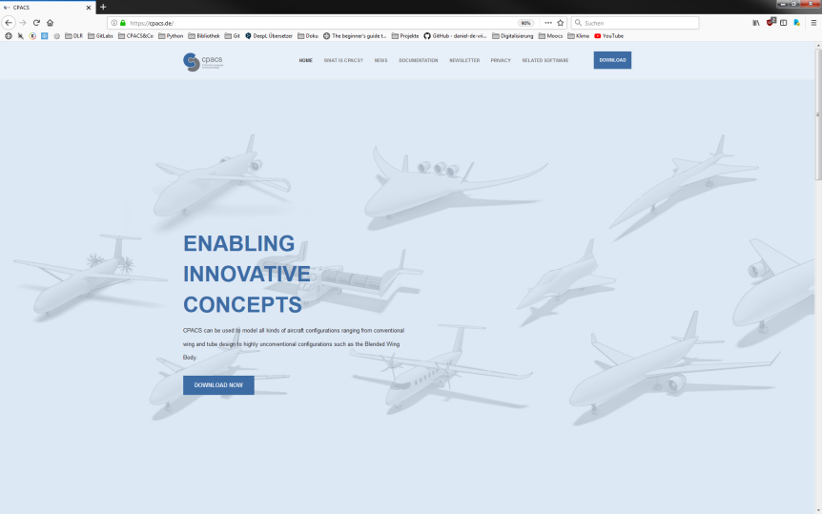
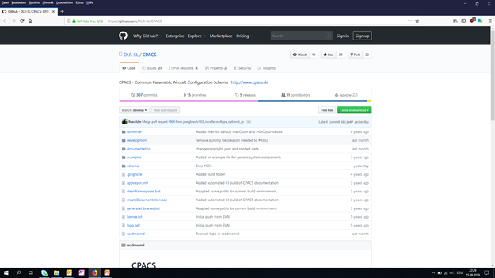
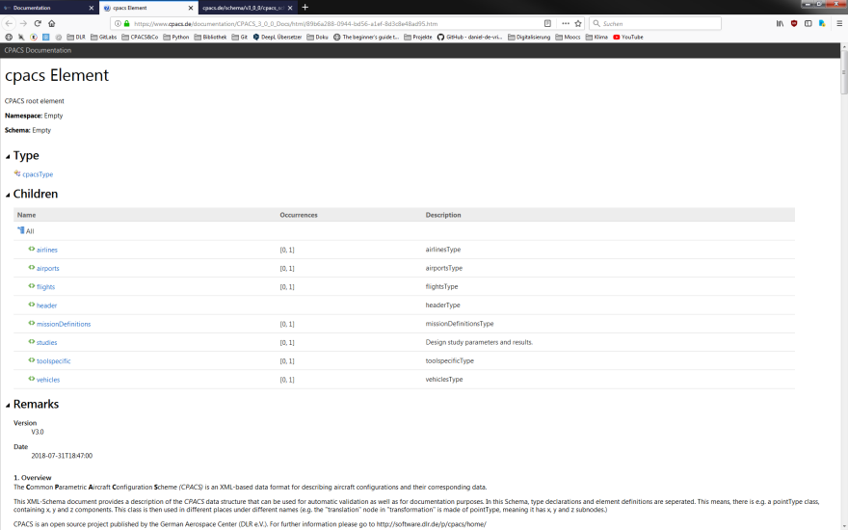
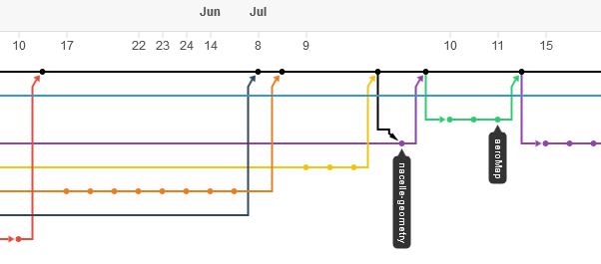

CPACS eco-system documentation, support, development
Homepage
download, news, newsletter, online help, link to other parts of eco-system
GitHub
version management, Q&A forum
https://cpacs.de
https://github.com/DLR-SL/CPACS

Slide 15
Data modeling via XML

Slide 16
XSD and XML

Slide 17
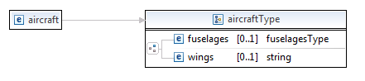
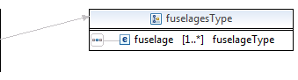
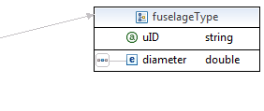
XSD and XML
XSD
XML
<?xml version="1.0" encoding="UTF-8"?>
<aircraft xmlns="http://www.w3.org/aircraft_schema" xmlns:xsi="http://www.w3.org/2001/XMLSchema-instance" xsi:schemaLocation="http://www.w3.org/aircraft_schema aircraft_schema.xsd ">
<fuselages>
<fuselage uID="fuselageRandomID">
<diameter>5</diameter>
</fuselage>
</fuselages>
<wings>wings</wings>
</aircraft>

Slide 18
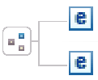

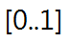

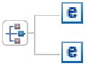
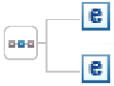
XSD and XML
XSD
Elements
Occurence
all
Types
Simple types
Complex types
choice
Attributes
sequence

Slide 19
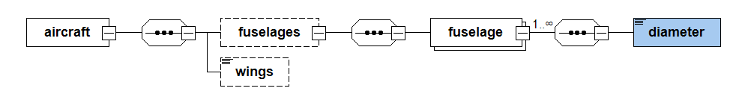
XSD and XML
XSD

Slide 20

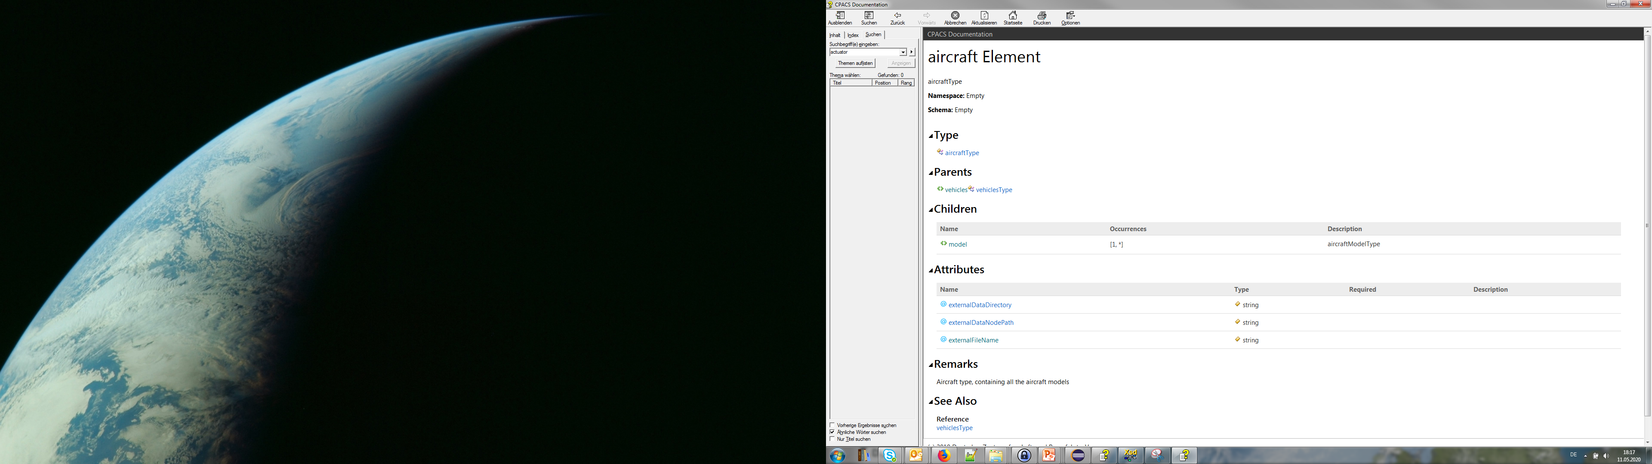
XSD and XML
Element name
Type of the element
Parents
Children
Occurences
Description
Attributes

Slide 21
Development process

Slide 22

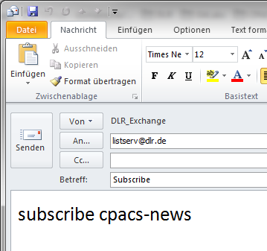
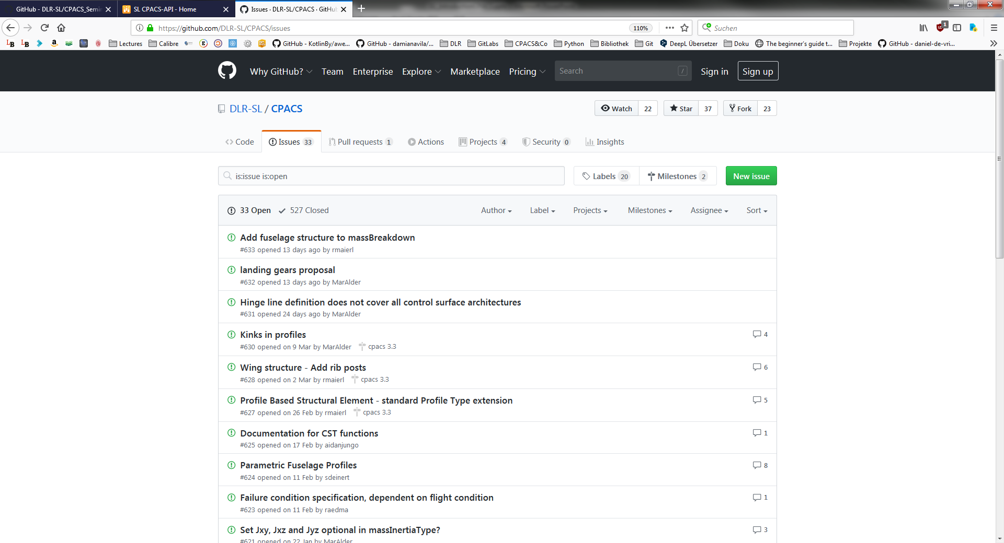

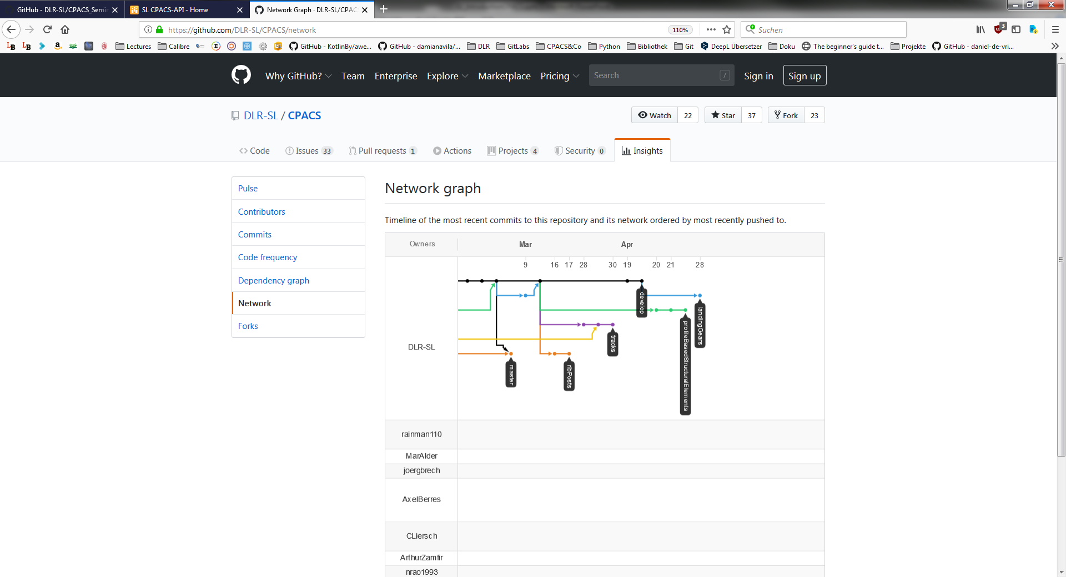

Development process

Slide 23
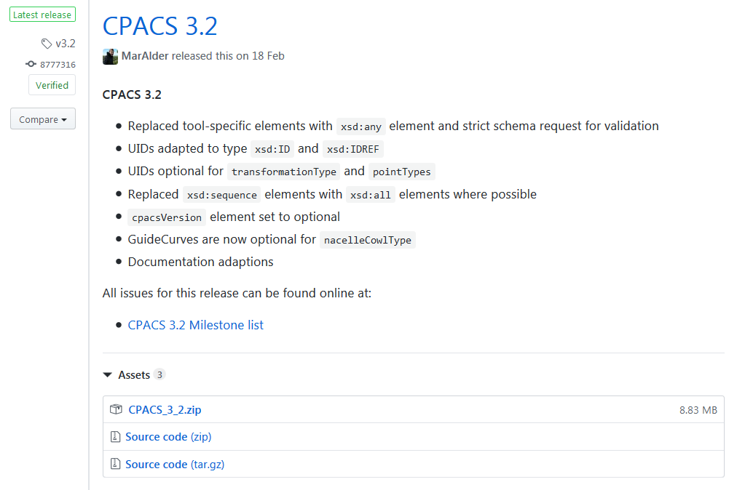
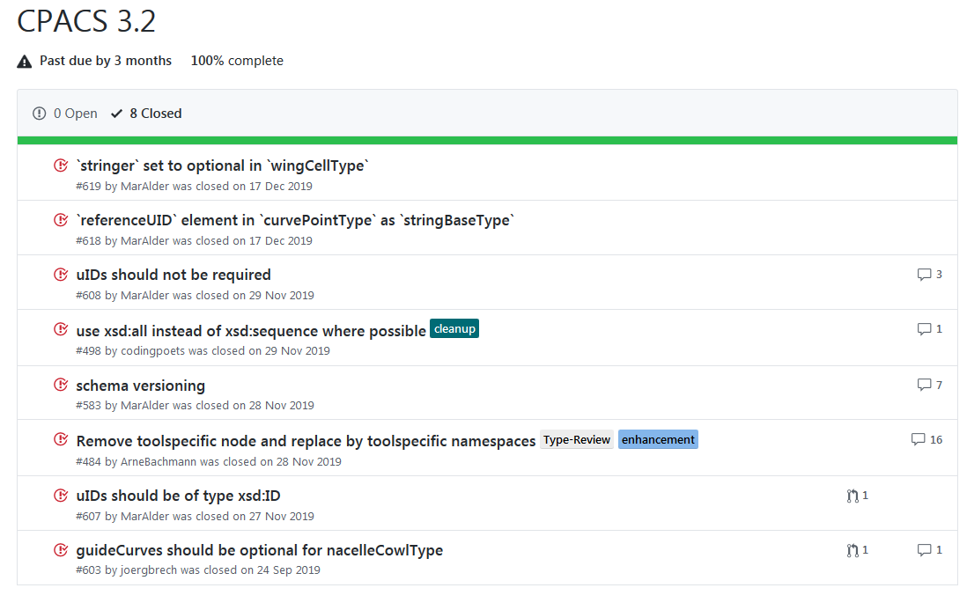


Development process
Pre-Release anouncement
> 4 weeks

Slide 24
Development process
https://github.com/DLR-SL/CPACS/tree/develop/development
https://github.com/DLR-SL/CPACS_Seminar

